Slide 1
Postcard Assignment
PrintNet T

Slide 2


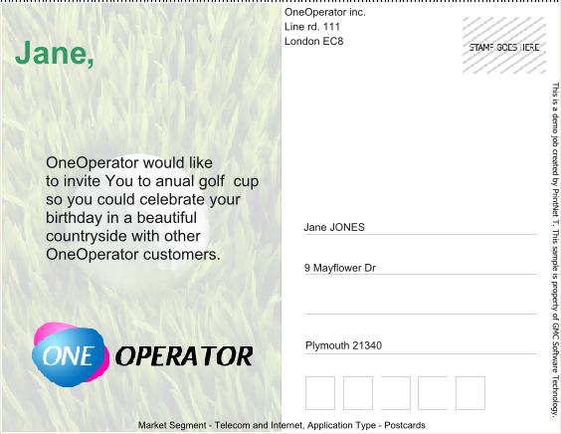
Postcard Assignment
In this assignment, you will create a job with the following design.
Page 1
Page 2

Slide 3


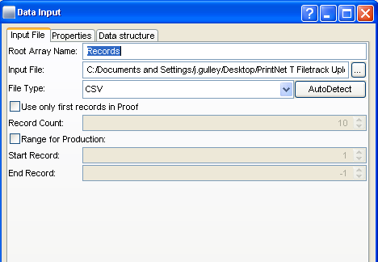
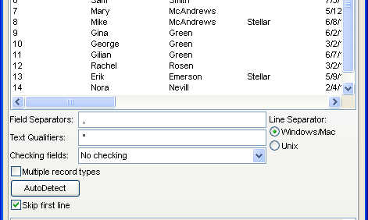
Step 1 – Data Input
  Insert a Data Input module into a new workflow.
  Use OneOperatorCustomers.csv as your input file.
  Check the input file to see what the field separator is!

Slide 4
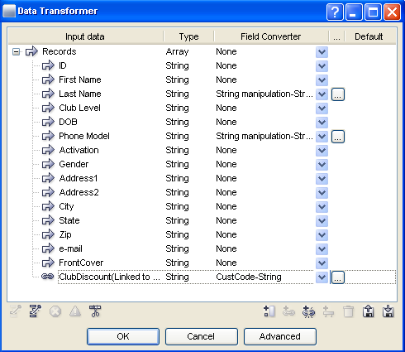
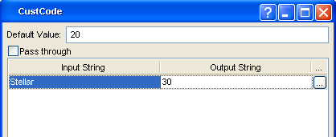
Step 2 – Data Manipulation
  Insert a Data Transformer.
  Create a new variable, ClubDiscount, linked to ClubLevel variable.
  Convert your data as follows:
    Last Name make uppercase
    Phone Model append the string “.png” at the end
    ClubDiscount make a CustCode conversion which has 20 as a default value and 30 as a value if “Stellar” is the input string.

Slide 5
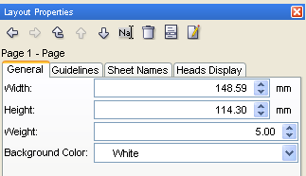
Step 3 – Layout
Create pages:
  Create another page in Layout, so that you have two in total.
  Change both pages’ sizes (148.59 X 114.30)

Slide 6




Step 4 – Layout
Insert images:
  Insert the following four images that have been provided.
  Arrange them in Layout on the two Layout pages as in the PDF example.
front.jpg
back.jpg
logo.png
logoONE.png

Slide 7
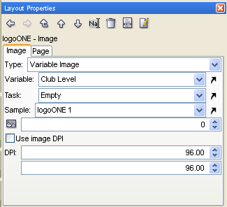
Step 5 – Layout
Set Variable Image:
The OneOperator logos are selected as a variable image.
  The “golf2007” logo will be selected if the customer is a “Stellar” customer (the variable for the variable image is Club Level).

Slide 8
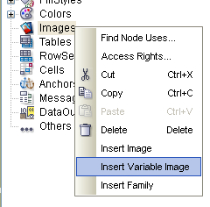
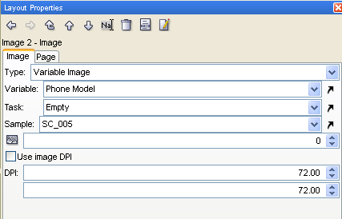
Step 6 – Layout
Add another variable image:
  Under “Images” in the Layout Tree, insert a new Variable Image.
  Use the 5 phone model images provided (variable is Phone Model)

Slide 9
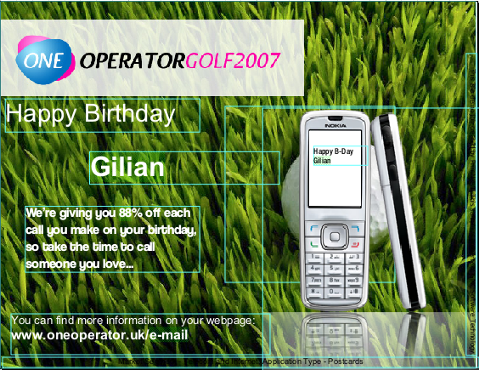
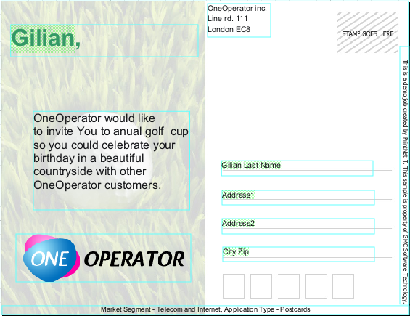
Step 7 – Layout
Add fixed and variable text:
  Type in fixed text (according to PDF)
  Drag variables from the Layout tree (according to PDF).
Variables

Slide 10

Thank You.
Do You Have Any Questions?

